Slide 1

Pandas at REST – an Intro to web dev
Jordan Jensen
3/20/2024

Slide 2

What is REST?
cease work or movement in order to relax, refresh oneself, or recover strength

Slide 3


Wait, what is the nerdy definition?
REST, or Representationt State Transfer, is an architectural style for providing standards between computer systems on the web, making it easier for systems to communicate with each other.
REST-compliant systems, often called RESTful systems, are characterized by how they are stateless and separate the concerns of client and server.

Slide 4


What will I cover?
Basic Web App
HTML + CSS + JS web app
NodeJS service layer
SQLite DB
External API calls (here’s where AI buzz words come in)
Debugging + Enhancing
VS Code Dev tools
Chrome Dev tools
Extensions – Chrome Performance Profiles + Lighthouse

Slide 5
What does my web app do?
Demonstrates REST
Show some Pandas!
REST API route: GET /api/pandas/
Create some Pandas!
REST API route: POST /api/pandas/
Delete all Pandas ☹
REST API route: DELETE /api/pandas/
Demonstrates Web Sockets
Web Socket broadcast events:
panda_created
panda_updated
panda_deleted
Demonstrates Integrations
AI Generated Imagery via an external service
REST API route: POST /sdapi/v1/txt2img

Slide 6

Well, lets see it then!
(Proceed with un-rehearsed demo)

Slide 7
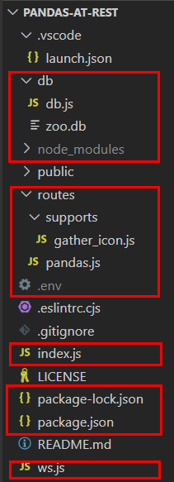
Web App Structure – Backend Server
db – holds our sqlite db (pandas are stored in the zoo), as well as the db driver in javascript
routes – all rest api routes for /api/* for the web app (/api/pandas is the only one defined)
index.js – starts the webserver
ws.js – handles websocket communication ith the front end (event based page updates)

Slide 8
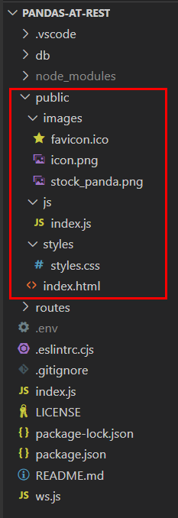
Web App Structure – Front End
public – all files to serve statically
images – images. Don’t know what else to say.
js – all front-end code to be interpreted by the browser
styles – any custom styles used other than bootstraps default
index.html – entry point loaded by the browser

Slide 9
Lets look at the code!
(Proceed with un-rehearsed code deep dive)

Slide 10
Demo Topics to hit
Using Postman vs Using Chrome Dev Tools
See the similarities and differences
Set a breakpoint, and show code step through
Using Visual Studio Dev Tools
Set a breakpoint, and show code step through + alteration
Extension topics
Chrome Performance Profiler – debug code flow, performance, and webpage timings
Chrome Lighthouse Profiler – improve page design and aria compliance, reduce code smells

